Slide 1
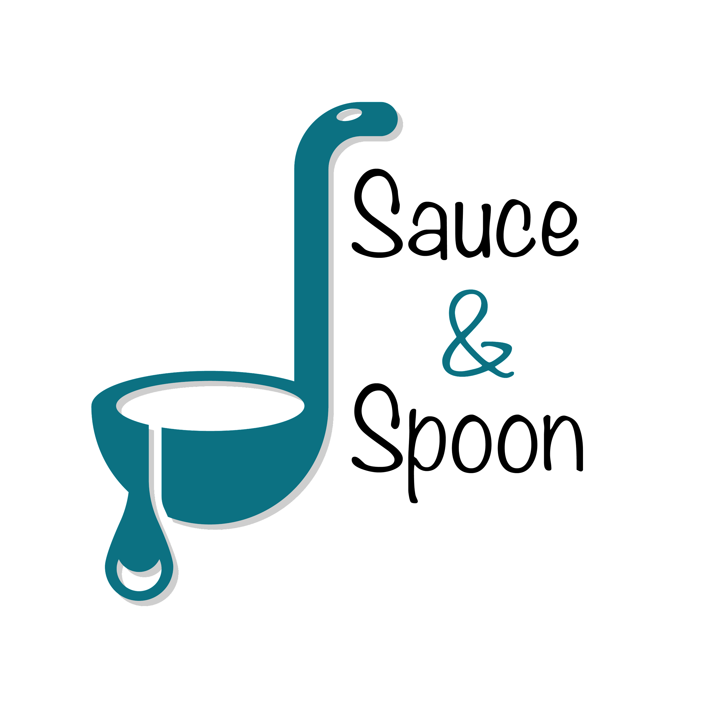
Evaluation findings

Slide 2
Successful completion of a test launch of the menu tablets in the North & Downtown Sauce & Spoon Locations.
Previous milestones:
Redesign of menu & user interface
Installation of tablets in bar areas
Training for all staff on tablet use
Summary

Slide 3
We conducted a survey for the 50 customers that participated in our test launch to measure the following areas related to our overall project goals:
Customer satisfaction with the tablet experience
Tablet ease-of-use
Order accuracy
Customer wait times
Overview

Slide 4
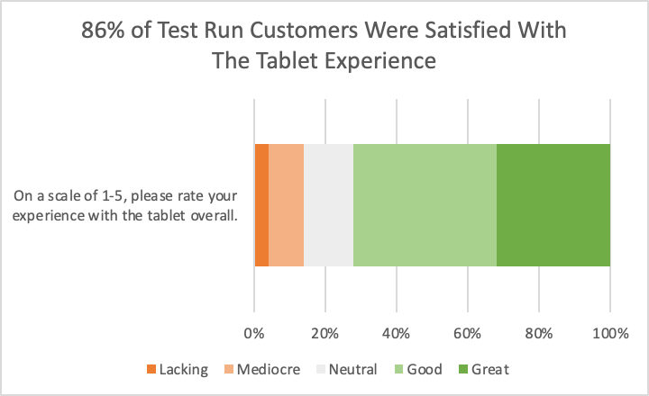
Overall, customers were
satisfied with the
experience and found the
tablets easy to use.
Focus should be on
improving staff accuracy
and efficiency with new
technology.
Findings

Slide 5
Survey results indicate that 28% of customers received an incorrectly prepared order. We should investigate the source of these errors and improve communication of substitutions and alterations to kitchen staff with the tablet system to meet our goal of 98% order accuracy.
Next Steps

Slide 6
Results also indicated that cash payments were slow to checkout using the tablet system, since it needed to be processed by the waitstaff. I recommend looking into ways to mitigate this inefficiency by allowing customers to indicate cash payment using the tablets or by moving to a card-only payment system.
Next Steps

